Slide 1



Assignment 3
Name: Raksha Pahariya
Email id: rakshapahariya1208@gmail.com
Role, Company: Student , IIEST Shibpur
Notes:
<Speaker Note>

Slide 2

Problem Statement
Onboarding: Signup for Notion through a new email, go through each of the 5-7 steps, and describe how each step helps the company provide a better onboarding experience to you
Activation: Try to book 1 property in Goa on Booking.com and identify what all strategies are being used to drive users to book right away. Take snapshots of the actual placement of those nudges on the website and write 2-3 sentences about why those strategies work. Bonus if you use the “4-part intent framework” described by Karan Peri
Retention: Take snapshots of at least 5 different notifications/emails that were sent to you (on the mobile app or email) and grade them on a scale of 1-10 on their personalization, similar to what Ankur Gattani did during his session on Retention. Also, add a 2-3 sentence explanation about why those notifications/emails are good/bad. For bad ones, write down text/email for what is a better nudge.
Pricing: Visit the pricing pages of any 2 websites/apps and describe what all psychological tactics (described by Deepak Abbot) were used by those companies to make users purchase

Slide 3
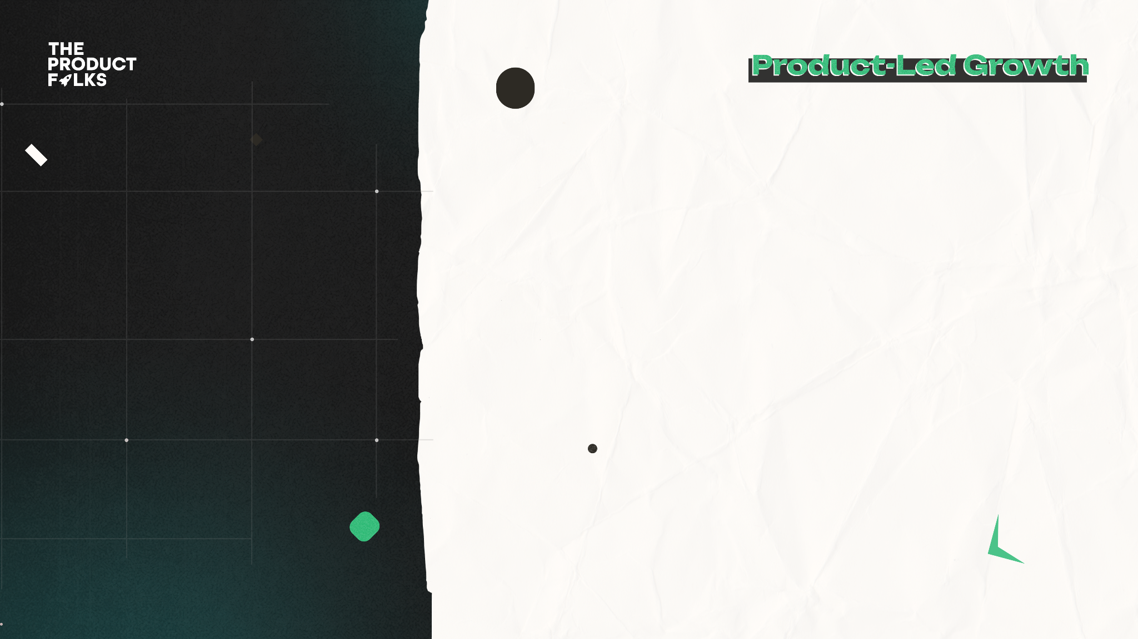
Background
Intent Framework
Existing User Flows
Optimised Flows
Metrics/Impact
Contents

Slide 4

Onboarding: Signup for Notion through a new email, go through each of the 5-7 steps, and describe how each step helps the company provide a better onboarding experience to you
Notion's onboarding process focuses on several key steps to provide a better experience for new users:
Email Verification: Verifying the email ensures accurate contact information and reduces the risk of user error or misuse.
Account Creation: Setting up a unique username and password maintains the security and privacy of the user's account.
Personalization: Allowing users to personalize their profile and interface creates a sense of ownership and engagement with the platform.

Slide 5
4. Guided Tour/Tutorial: Providing a guided tour or tutorial helps users understand the platform's features and functionalities quickly.
5. Sample Content and Templates: Offering pre-made structures and examples saves users time and inspires them with different ways to use the platform.
6. User Support and Help Center: Accessible support resources such as a help center, FAQs, and live chat ensure users can address any questions or issues.
7. Onboarding Progress Tracking: Visual indicators or checklists help users track their progress and stay organized throughout the onboarding process
Notion's focus on these steps aims to streamline user onboarding, enhance user satisfaction, and empower users to make the most of the platform.
PROCESS

Slide 6
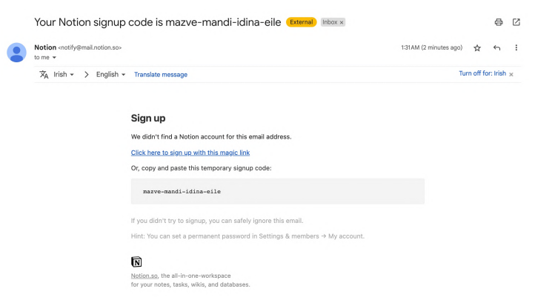

Slide 7
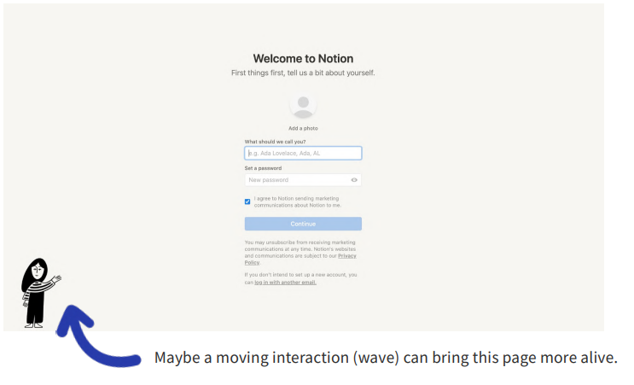

Slide 8
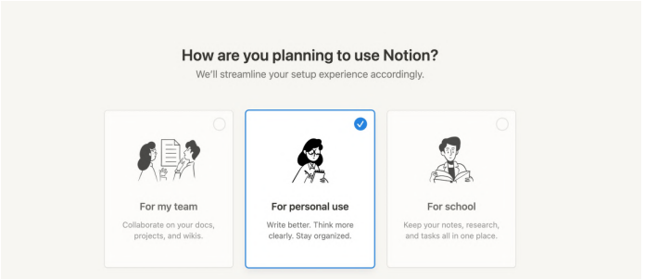

Slide 9
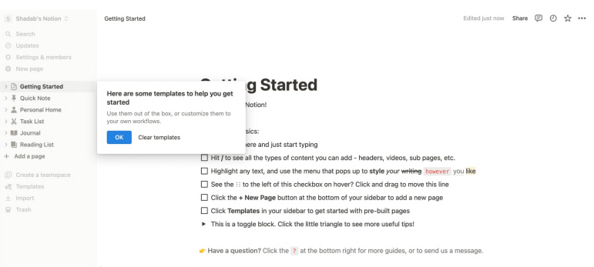

Slide 10
Activation: Try to book 1 property in Goa on Booking.com and identify what all strategies are being used to drive users to book right away. Take snapshots of the actual placement of those nudges on the website and write 2-3 sentences about why those strategies work. Bonus if you use the “4-part intent framework” described by Karan Peri
Notion's onboarding process focuses on several key steps to provide a better experience for new users:
Email Verification: Verifying the email ensures accurate contact information and reduces the risk of user error or misuse.
Account Creation: Setting up a unique username and password maintains the security and privacy of the user's account.
Personalization: Allowing users to personalize their profile and interface creates a sense of ownership and engagement with the platform.

Slide 11
Intent framework

Slide 12
Existing User Flow
User Flow 1
User Flow 2

Slide 13
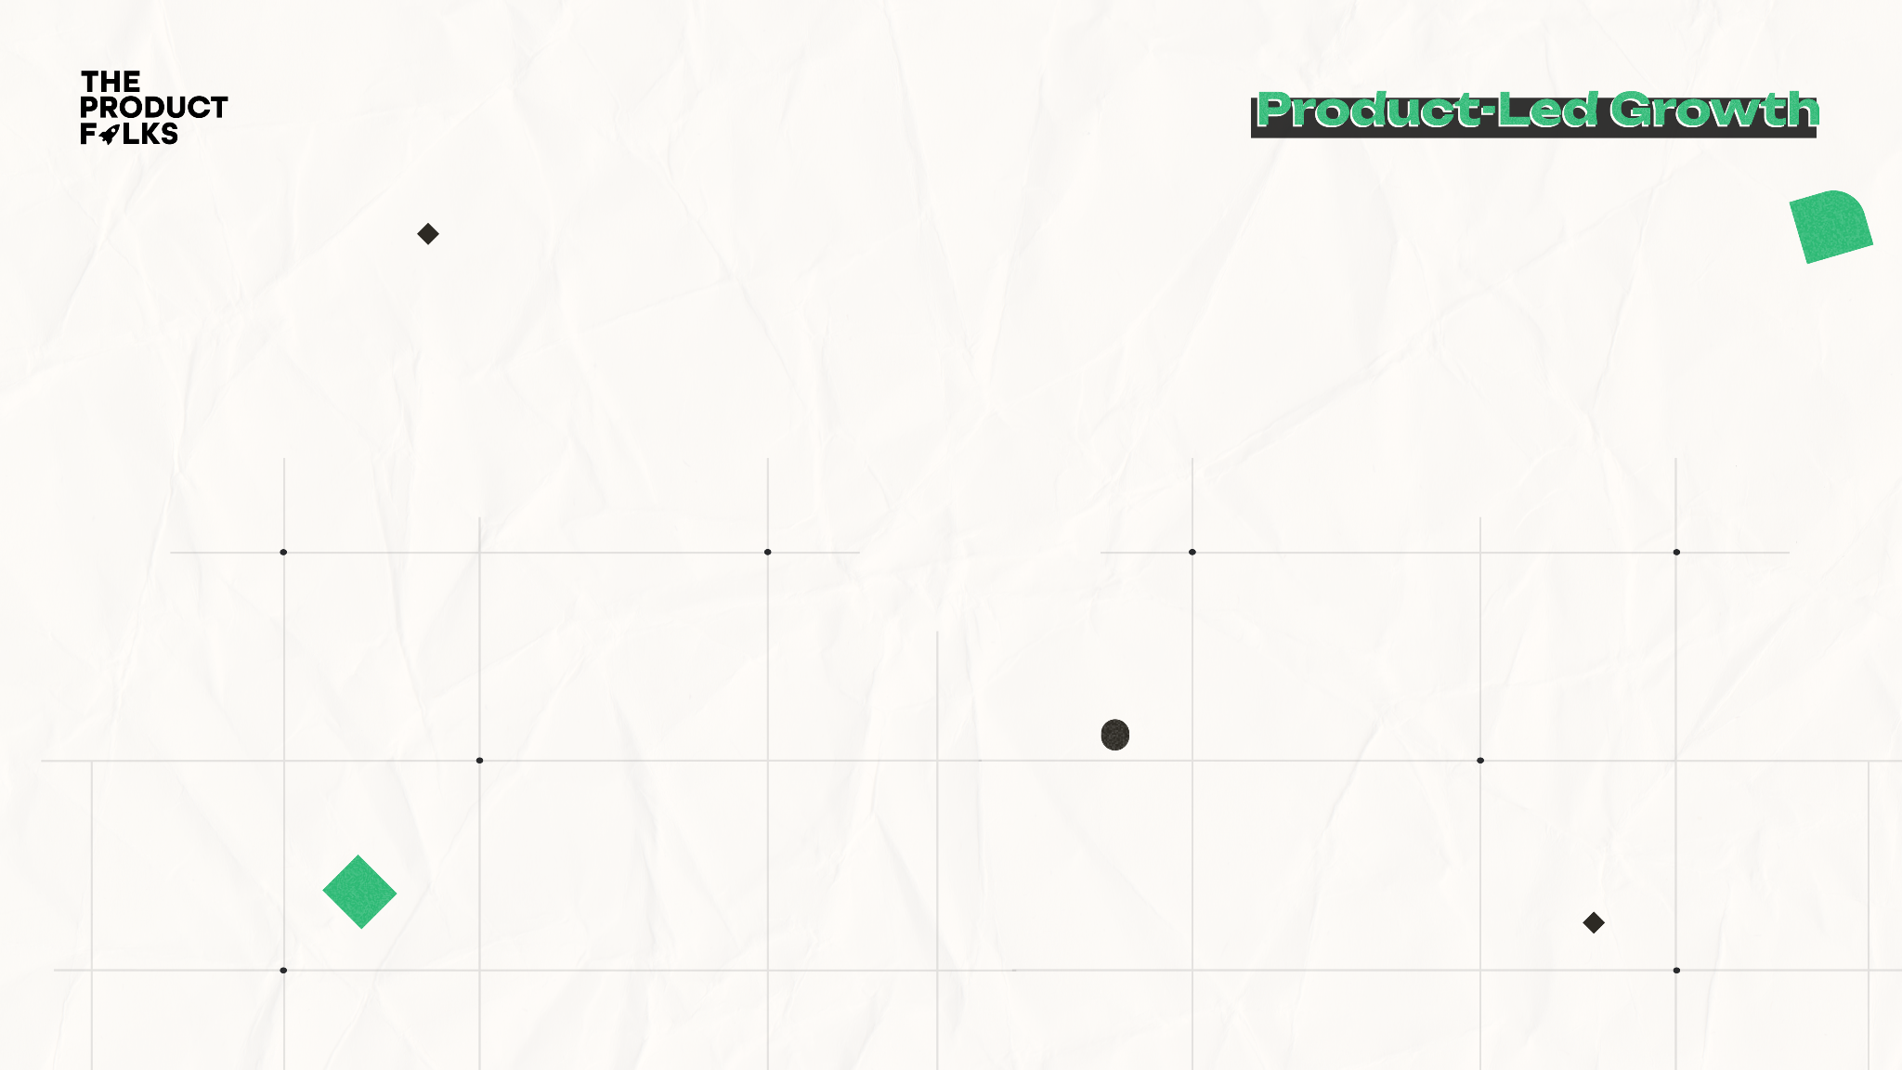
Insights into the strategies commonly used on booking platforms like Booking.com to drive users to book right away, using the "4-part intent framework" described by Karan Peri.
Urgency/Scarcity : One strategy often employed is the use of urgency and scarcity. This can be seen through messages such as "Only 1 room left!" or "10 people are viewing this property." By creating a sense of urgency and scarcity, Booking.com aims to motivate users to book immediately to secure the property before it's no longer available.
Social Proof: : Another strategy is leveraging social proof to encourage bookings. This is often achieved by displaying messages such as "1000+ bookings in the last 24 hours" or "Recommended by 80% of guests." By showcasing the popularity and positive reviews of a property, Booking.com builds trust and credibility, influencing users to make a booking decision.

Slide 14
3.Value Proposition: Booking.com emphasizes the value proposition of a property through various strategies. They may highlight discounts, special offers, or promotional deals to entice users to book. Additionally, displaying key amenities and features of the property, such as "Free cancellation" or "Breakfast included," helps communicate the value users will receive by making a booking.
4. Ease of Booking: To facilitate quick and easy bookings, Booking.com optimizes the user experience by streamlining the booking process. They prominently display the "Book Now" button, provide a clear summary of the total price, and offer a straightforward reservation form. By reducing friction and simplifying the booking process, Booking.com encourages users to proceed with their reservation without hesitation.
These strategies work by appealing to different aspects of user intent. Urgency and scarcity trigger the fear of missing out (FOMO) and create a sense of urgency to act immediately. Social proof taps into users' desire for validation and reassurance by leveraging the experiences of other guests. Value proposition highlights the benefits and advantages of making a booking, showcasing the value users will receive. Finally, ease of booking addresses users' need for convenience and simplicity, ensuring a smooth and hassle-free reservation process.

Slide 15
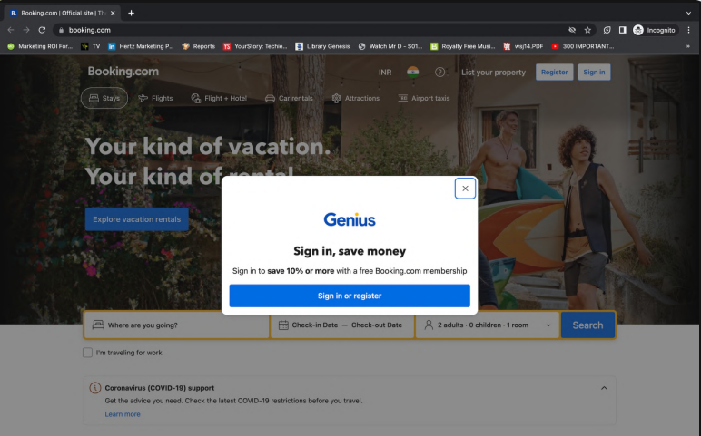

Slide 16
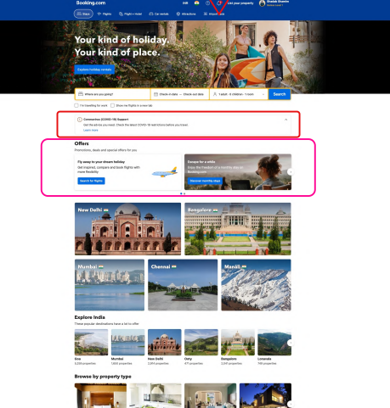

Slide 17
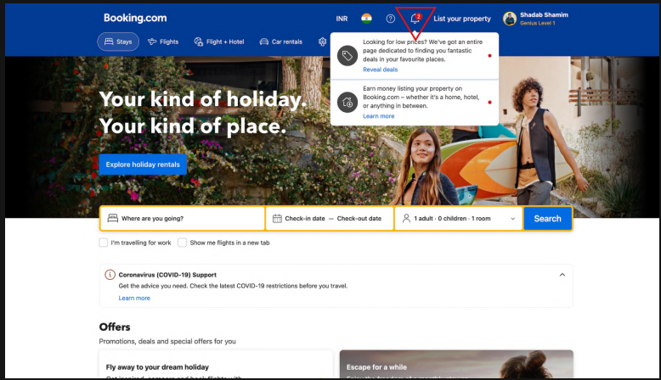

Slide 18
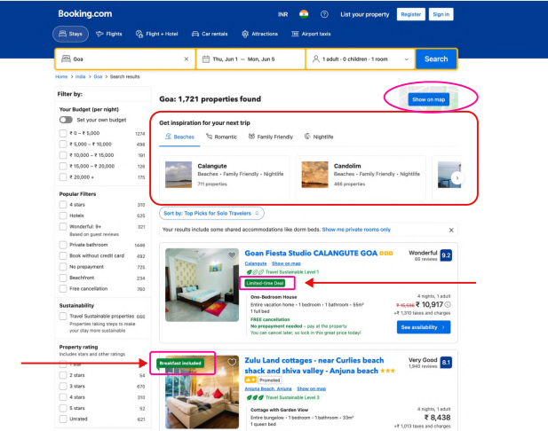

Slide 19
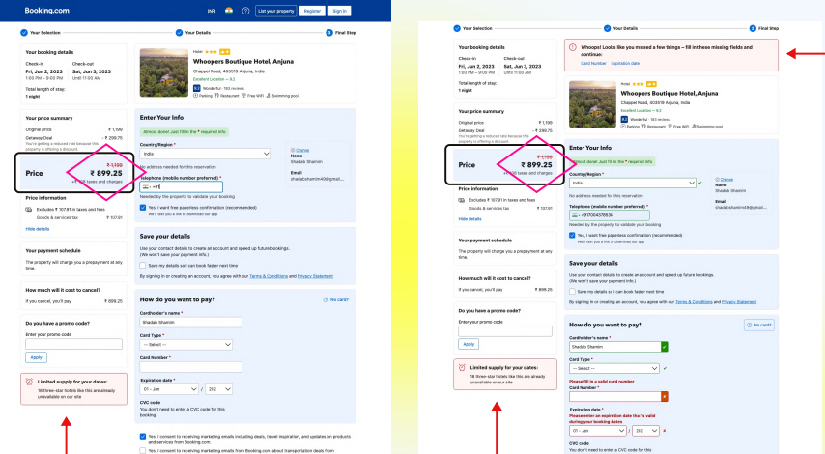

Slide 20
Optimized
User Flow
User Flow 1
User Flow 2

Slide 21
Retention: Take snapshots of at least 5 different notifications/emails that were sent to you (on the mobile app or email) and grade them on a scale of 1-10 on their personalization, similar to what Ankur Gattani did during his session on Retention. Also, add a 2-3 sentence explanation about why those notifications/emails are good/bad. For bad ones, write down text/email for what is a better nudge.
Good Notifications/Emails (with explanation):
Personalization: 9/10
A good notification/email addresses the recipient by their name and provides personalized content tailored to their preferences and behavior. It may include personalized recommendations based on past interactions or specific offers relevant to their interests. Personalization enhances engagement by making the recipient feel valued and understood.

Slide 22
Triggered by User Activity: 8/10 — Relevant notifications/emails triggered by specific user actions or milestones can be effective. For example, a follow-up email after completing a purchase or a reminder to revisit the platform after a period of inactivity. By responding to user behavior, these notifications show attentiveness and encourage continued interaction.
Bad Notifications/Emails (with suggested improvement):
Generic Promotional Email: 4/10 — A generic promotional email with no personalization or relevance to the recipient's preferences or actions is not effective. To improve, the email could be customized to highlight specific offers or recommendations based on the recipient's previous bookings or interests, making it more personalized and engaging.
Inactive Account Notification: 6/10 — An email notifying about an inactive account can be a good reminder, but it may lack personalization. To improve, the email could include personalized suggestions based on the recipient's previous activity or recommendations tailored to their interests, motivating them to re-engage with the platform.

Slide 23
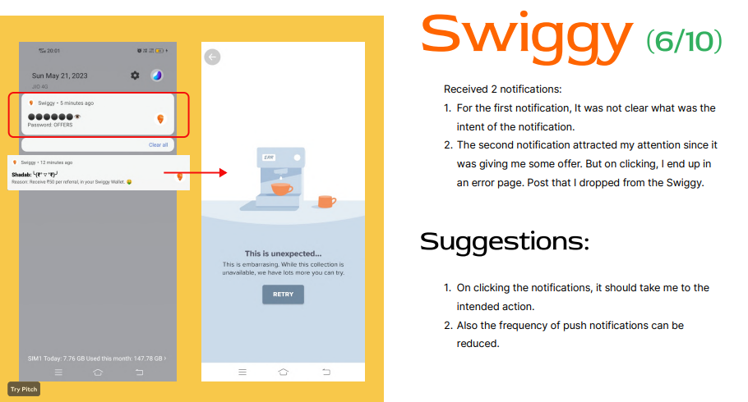

Slide 24
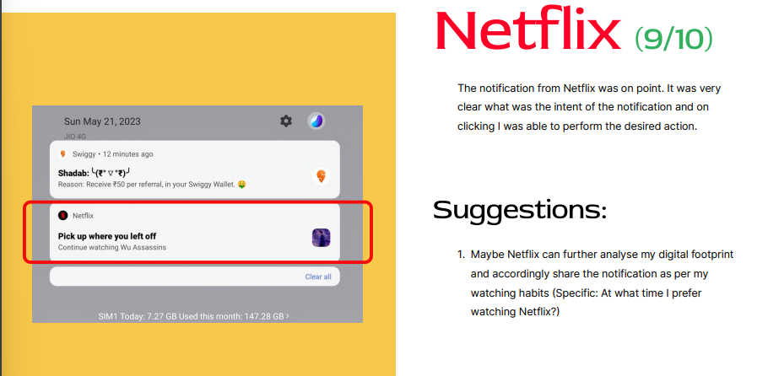

Slide 25
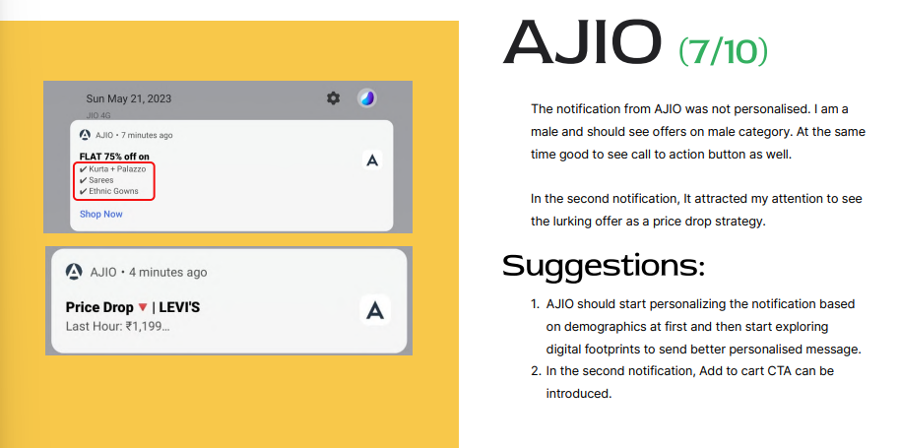

Slide 26
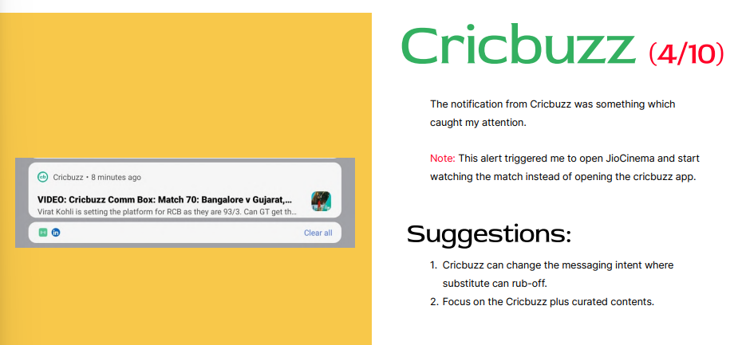

Slide 27
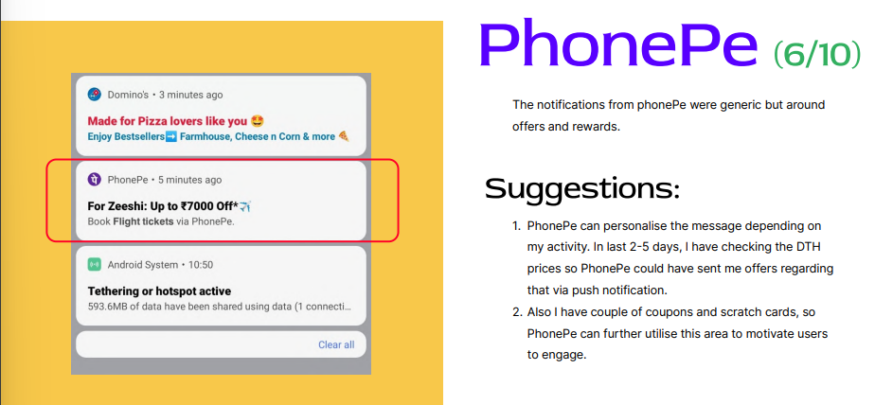

Slide 28
These tactics are based on the principles described by Deepak Abbot, a well-known expert in product management and growth. Here are a few examples:
Anchoring: Companies use anchoring by presenting multiple pricing tiers or options, with one option being highlighted as the "recommended" or "most popular." This creates a reference point (anchor) for users and influences their perception of value, making them more likely to choose the recommended option.
Scarcity: Creating a sense of scarcity is a powerful tactic to drive purchases. Companies may use countdown timers, limited-time offers, or limited availability of certain features or discounts to make users feel the urgency to buy before the opportunity is lost.
Social Proof: Leveraging social proof is a common tactic to build trust and credibility. Companies may display testimonials, customer reviews, or showcase the number of customers/users they have. By highlighting the positive experiences of others, they create a persuasive influence on potential buyers.

Slide 29
4. Free Trials or Freemium Models: Offering free trials or freemium models is an effective strategy to reduce purchase barriers. By providing a taste of the product or service at no cost, companies aim to engage users, showcase value, and increase the likelihood of conversion to a paid plan.
5. Pricing Bundles: Companies often offer pricing bundles or packages that combine multiple products or services at a discounted price. This tactic taps into users' desire for value and cost savings by presenting a compelling offer that provides more for less.
6. Risk Reversal: To mitigate user concerns and fears, companies may offer money-back guarantees, hassle-free returns, or no-obligation cancellations. This tactic reduces perceived risk and instills confidence in the purchase decision, making users more inclined to proceed.
7. Limited Features in Lower Tiers: Some companies limit certain features or functionality in lower-priced tiers to encourage users to upgrade to higher-priced plans. This tactic creates a perceived value gap and motivates users to opt for higher-priced options to gain access to all desired features.
It's important to note that the effectiveness of these psychological tactics can vary based on the specific industry, target audience, and product/service being offered. Companies often experiment and iterate on their pricing pages to find the most persuasive and compelling strategies for their particular user base.

Slide 30
Thank You!

